Slide 1
MS 101: Algorithms
Instructor
Neelima Gupta
ngupta@cs.du.ac.in

Slide 2
Table Of Contents
Merge Sort
Solving Recurrences
The Master Theorem
HeapSort
Quicksort

Slide 3
Merge Sort
MergeSort(A, left, right) {
if (left < right) {
mid = floor((left + right) / 2);
MergeSort(A, left, mid);
MergeSort(A, mid+1, right);
Merge(A, left, mid, right);
}
}
// Merge() takes two sorted subarrays of A and
// merges them into a single sorted subarray of A
// (how long should this take?)

Slide 4
Analysis of Merge Sort
Statement Effort
So T(n) = Θ(1) when n = 1, and 2T(n/2) + Θ(n) when n > 1
So what is T(n)?
MergeSort(A, left, right) { T(n)
if (left < right) { Θ(1)
mid = floor((left + right) / 2); Θ(1)
MergeSort(A, left, mid); T(n/2)
MergeSort(A, mid+1, right); T(n/2)
Merge(A, left, mid, right); Θ(n)
}
}

Slide 5
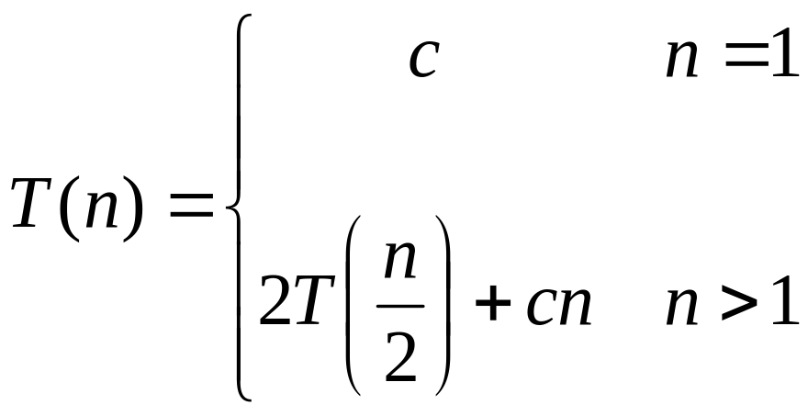
Recurrences
The expression:
is a recurrence.
  Recurrence: an equation that describes a function in terms of its value on smaller functions

Slide 6

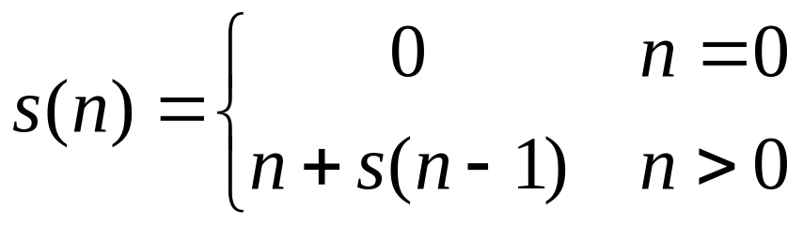

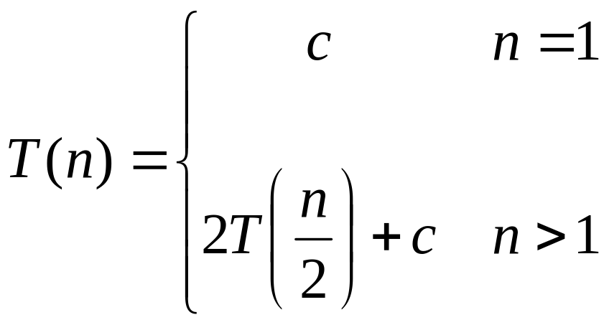
Recurrence Examples

Slide 7
Solving Recurrences
Substitution method
Iteration method
Master method

Slide 8
Solving Recurrences
The substitution method (CLR 4.1)
  “Making a good guess” method
  Guess the form of the answer, then use induction to find the constants and show that solution works
  Examples:
    T(n) = 2T(n/2) + Θ(n) → T(n) = Θ(n lg n)
    T(n) = 2T(⎣n/2⎦) + n → ???

Slide 9
Solving Recurrences
The substitution method (CLR 4.1)
  “Making a good guess” method
  Guess the form of the answer, then use induction to find the constants and show that solution works
  Examples:
    T(n) = 2T(n/2) + Θ(n) → T(n) = Θ(n lg n)
    T(n) = 2T(⎣n/2⎦) + n → T(n) = Θ(n lg n)
    T(n) = 2T(⎣n/2⎦ )+ 17) + n → ???

Slide 10
Solving Recurrences
Another option is “iteration method”
  Expand the recurrence
  Work some algebra to express as a summation
  Evaluate the summation
We will show several examples

Slide 11
Assignment 4
Use iterative method to show that the solution to the following recurrence is Θ(n).
  S(n) = c + S(n-1) for n>0 and, = 0 if n=0
Use substitution method to show that the solution to the following recurrence is Θ(n lg n).
T(n) = 2T(n/2) + Θ(n)

Slide 12
The Master Theorem
Given: a divide and conquer algorithm
  An algorithm that divides the problem of size n into a subproblems, each of size n/b
  Let the cost of each stage (i.e., the work to divide the problem + combine solved subproblems) be described by the function f(n)
Then, the Master Theorem gives us a cookbook for the algorithm’s running time:

Slide 13
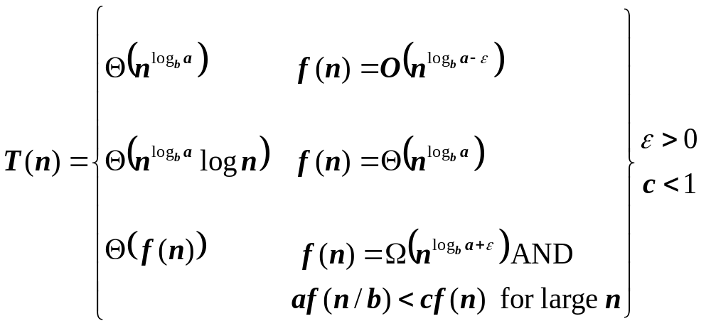
The Master Theorem
if T(n) = aT(n/b) + f(n) then

Slide 14
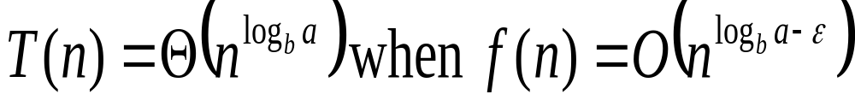
Using The Master Method
T(n) = 9T(n/3) + n
  a=9, b=3, f(n) = n
  n^{logb a} = n^{log3 9} = Θ(n²)
  Since f(n) = O(n^{log3 9 - ε}), where ε=1, case 1 applies:
  Thus the solution is T(n) = Θ(n²)

Slide 15
More Examples of Master’s Theorem

Slide 16
When Master’s Theorem cannot be applied

Slide 17
Sorting Revisited
So far we’ve talked about two algorithms to sort an array of numbers
  What is the advantage of merge sort?
  What is the advantage of insertion sort?
Next on the agenda: Heapsort
  Combines advantages of both previous algorithms

Slide 18
Merge Sort Vs Insertion Sort
Merge Sort is faster but does not take advantage if the list is already partially sorted.
Insertion Sort takes advantage if the list is already partially sorted.

Slide 19
Heapsort
Heapsort(A)
{
BuildHeap(A);
for (i = length(A) downto 2)
{
Swap(A[1], A[i]);
heap_size(A) -= 1;
Heapify(A, 1);
}
}

Slide 20
Analyzing Heapsort
The call to BuildHeap() takes O(n) time
Each of the n - 1 calls to Heapify() takes O(lg n) time
Thus the total time taken by HeapSort()
= O(n) + (n - 1) O(lg n)
= O(n) + O(n lg n)
= O(n lg n)

Slide 21
In-place sorting
A sorting algorithm is said to be in-place if it takes at most constant amount of extra space.
Which of the algorithms you have studied are in-place?

Slide 22
Quicksort
Sorts O(n lg n) in the average case
Sorts O(n²) in the worst case
So why would people use it instead of merge sort?
  But in practice, it’s quick
  And the worst case doesn’t happen often (but more on this later…)

Slide 23
Analyzing Quicksort
What will be the worst case for the algorithm?
  Partition is always unbalanced
What will be the best case for the algorithm?
  Partition is perfectly balanced
Which is more likely?
  The latter, by far, except...
Will any particular input elicit the worst case?
  Yes: Already-sorted input

Slide 24
Analyzing Quicksort
What will be the worst case for the algorithm?
  Partition is always unbalanced
What will be the best case for the algorithm?
  Partition is perfectly balanced
Which is more likely?
  The latter, by far, except...
Will any particular input elicit the worst case?
  Yes: Already-sorted input

Slide 25
Analyzing Quicksort
In the worst case:
  T(1) = Θ(1)
  T(n) = T(n - 1) + Θ(n)
Works out to
T(n) = Θ(n²)

Slide 26
Analyzing Quicksort
In the best case:
  T(n) = 2T(n/2) + Θ(n)
What does this work out to?
  T(n) = Θ(n lg n)

Slide 27
Improving Quicksort
The real liability of quicksort is that it runs in O(n²) on already-sorted input
Book discusses two solutions:
  Randomize the input array, OR
  Pick a random pivot element
How will these solve the problem?
  By insuring that no particular input can be chosen to make quicksort run in O(n²) time

Slide 28
Analyzing Quicksort: Average Case
Assuming random input, average-case running time is much closer to O(n lg n) than O(n²)
First, a more intuitive explanation/example:
  Suppose that partition() always produces a 9-to-1 split. This looks quite unbalanced!
  The recurrence is thus:
  T(n) = T(9n/10) + T(n/10) + n
  How deep will the recursion go? (draw it)
Use n instead of O(n)
for convenience (how?)

Slide 29
Analyzing Quicksort: Average Case
Intuitively, a real-life run of quicksort will produce a mix of “bad” and “good” splits
  Randomly distributed among the recursion tree
  Pretend for intuition that they alternate between best-case (n/2 : n/2) and worst-case (n-1 : 1)
  What happens if we bad-split root node, then good-split the resulting size (n-1) node?

Slide 30
Analyzing Quicksort: Average Case
Intuitively, a real-life run of quicksort will produce a mix of “bad” and “good” splits
  Randomly distributed among the recursion tree
  Pretend for intuition that they alternate between best-case (n/2 : n/2) and worst-case (n-1 : 1)
  What happens if we bad-split root node, then good-split the resulting size (n-1) node?
    We fail English

Slide 31
Analyzing Quicksort: Average Case
Intuitively, a real-life run of quicksort will produce a mix of “bad” and “good” splits
  Randomly distributed among the recursion tree
  Pretend for intuition that they alternate between best-case (n/2 : n/2) and worst-case (n-1 : 1)
  What happens if we bad-split root node, then good-split the resulting size (n-1) node?
    We end up with three subarrays, size 1, (n-1)/2, (n-1)/2
    Combined cost of splits = n + n -1 = 2n -1 = O(n)
    No worse than if we had good-split the root node!

Slide 32
Analyzing Quicksort: Average Case
Intuitively, the O(n) cost of a bad split
(or 2 or 3 bad splits) can be absorbed
into the O(n) cost of each good split
Thus running time of alternating bad and good splits is still O(n lg n), with slightly higher constants
How can we be more rigorous?

Slide 33
Analyzing Quicksort: Average Case
For simplicity, assume:
  All inputs distinct (no repeats)
  Slightly different partition() procedure
    partition around a random element, which is not included in subarrays
    all splits (0:n-1, 1:n-2, 2:n-3, … , n-1:0) equally likely
What is the probability of a particular split happening?
Answer: 1/n

Slide 34
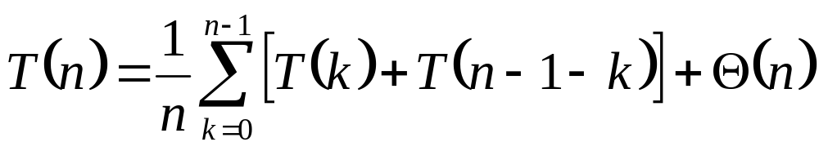
Analyzing Quicksort: Average Case
So partition generates splits
(0:n-1, 1:n-2, 2:n-3, … , n-2:1, n-1:0)
each with probability 1/n
If T(n) is the expected running time,
What is each term under the summation for?
What is the Θ(n) term for?

